Slide 1
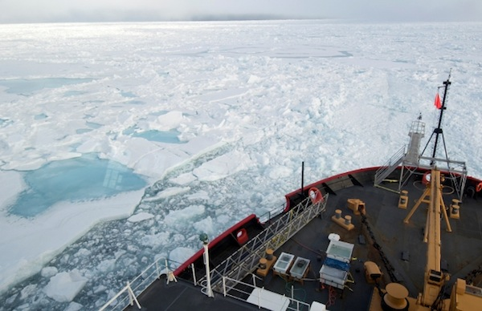
ADAC Year 6 Annual Meeting
ADAC Project Briefing
Great Lakes Ice Conditions Index (ICECON)
Arctic Ice Conditions Index (ARCTICE)
Jifeng Peng, University of Alaska Anchorage
Shawn Butler, University of Alaska Anchorage
Kelsey Frazier, University of Alaska Anchorage

Slide 2
ADAC Project: Arctic Ice Conditions Index (ARCTICE)
ADAC Program Year 6 Annual Meeting 14 May 2020
Project Principal Investigator(s)
  Dr. Jifeng Peng, University of Alaska Anchorage
Supporting Team
  Dr. Shawn Butler, University of Alaska Anchorage
  Kelsey Frazier, University of Alaska Anchorage
Project Champions
  CDR Christopher Tuckey, CG-WWM
  LCDR James Gatz, CG-WWM
Project Support
  Sam Cheung, CG RDC
Project Collaborators
  Jonathan Edwards-Opperman, NIC
  Lt. Jason Radcliffe, CG D9
  Capt. (Ret) Phillip Thorne, CG D17
  Axiom Data Science

Slide 3
Great Lakes Ice Condition Index (ICECON):
Project Description
ADAC Program Year 6 Annual Meeting 14 May 2020
The Ice Condition Index (ICECON) is a decision support tool for the management of winter maritime transit in the Great Lakes
The ICECON scale describes ice conditions severity for the Great Lakes
  Similar to the mariner’s Saffir-Simpson scale (hurricanes) and the Beaufort scale (high winds)
ICECON is formed from several ice-related environmental parameters
ICECON provides 72 hour forecast for USCG ice breaking mission planning

Slide 4
ADAC Program Year 6 Annual Meeting 14 May 2020
ICECON Classification
Total Score | ICECON | Impacts to Vessels
0 | 0 | No Ice present or imminent.
0-15 | 1 | Minimum ice concentrations and thickness. Does not present hindrance to commercial navigation.
16 -30 | 2 | Light Ice conditions present. Still open water areas. May be some hindrance to less ice-capable ships.
31 -50 | 3 | Light-to-moderate ice conditions present. Less ice-capable ships may need icebreaker assistance for transit and/or be at risk for damage.
51 -75 | 4 | Moderate-to-Heavy Ice conditions present. All Commercial ships may require icebreaker assistance for transit.
>75 | 5 | Heavy-to-extreme ice conditions. All transits require icebreaker escort.

Slide 5
ADAC Program Year 6 Annual Meeting 14 May 2020
Previous Work
Initial version of ICECON used data from Great Lakes Coastal Forecast System (GLCFS) from NOAA’s Great Lakes Environmental Research Laboratory (GLERL);
GLCFS model is still experimental; therefore, in June 2019 the ADAC team, USCG, and USNIC decided to move to Canada’s Water Cycle Prediction System (WCPS) from Environment and Climate Change Canada (ECCC) as the ICECON data source.

Slide 6
ADAC Program Year 6 Annual Meeting 14 May 2020
WCPS as Data Source
An operational model with 72 hour forecast at 2km spatial resolution
WCPS couples Global Environmental Multi-scale (GEM) model:
  Surface and soil model Interactions between Soil, Biosphere, and Atmosphere (ISBA);
  Lake/ocean model NEMO;
  Los Alamos Sea Ice Model (CICE);
  River-routing model WATROUTE; and
  Coordinated Great Lakes Regulation and Routing Model (CGLRRM);
Data includes all parameters required for ICECON calculation, including ice pressure.

Slide 7
ADAC Program Year 6 Annual Meeting 14 May 2020
Transition to an Operational Product
  WCPS Beta version available in Dec 2019; final product available on Datamart in Feb 2020;
  Revised to automatically provide daily updates and forecasts;
  ICECON data hosted at Axiom Data Science(ADS)
    also hosts other ADAC operational products;
  ADS sends graphical product forecasts (1, 6, 12, 24, 48, 72 hour intervals) daily via email to USCG;
  Products include ICECON in png charts and geotiff files (USNIC requested).

Slide 8
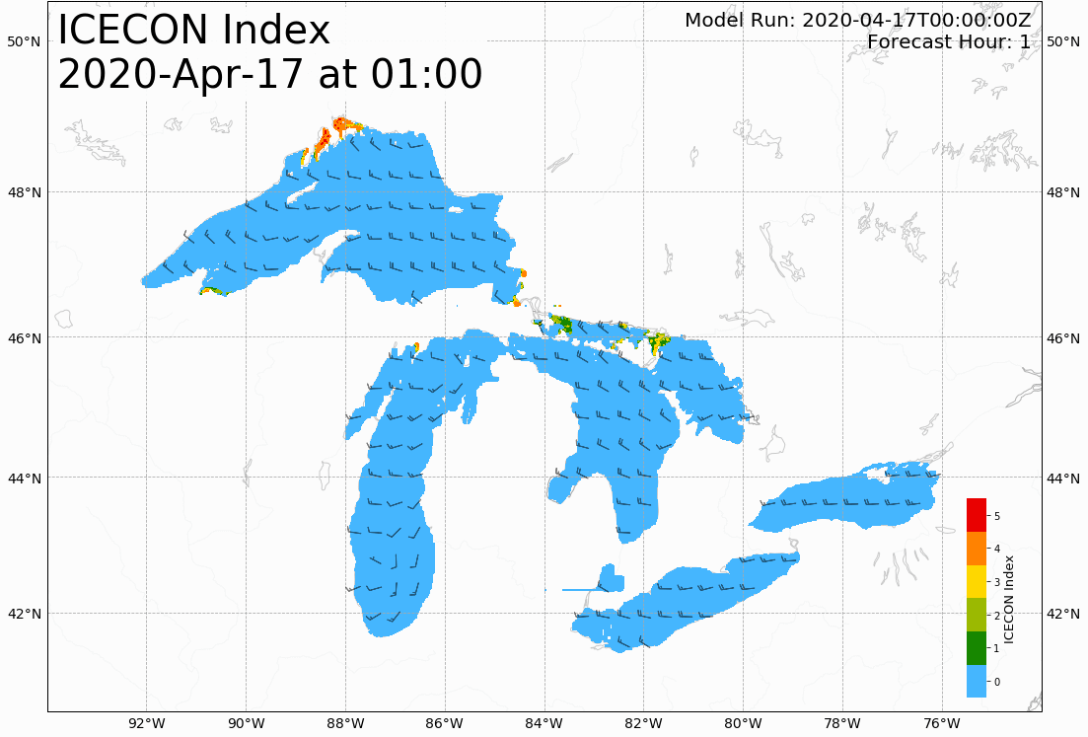
An ICECON forecast for 72 hours
ADAC Program Year 6 Annual Meeting 14 May 2020

Slide 9
ADAC Program Year 6 Annual Meeting 14 May 2020
Project Status
ICECON automation completed
Email distribution established
Currently conducting trial runs
User technical documentation drafted
Documentation webpage currently in development

Slide 10
ADAC Program Year 6 Annual Meeting 14 May 2020
Mobile Data Collection App
Prior data collection was ad hoc, and ship’s weather observation data delivery to USGC was not straightforward;
Now, a sailor on a ship can simply open the App and make a data entry based on observation;
Upon connection to internet during or after sailing, all data entry recorded during the sailing are delivered to a specified computer server for data storage;
A previous beta-version sent to USCG D9 and in use.

Slide 11
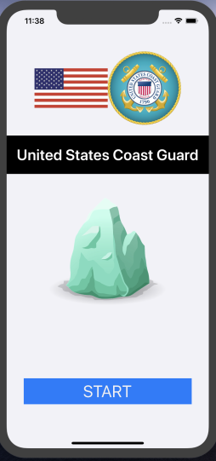
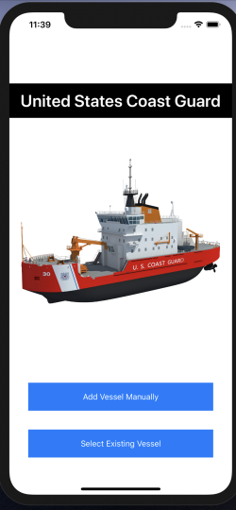
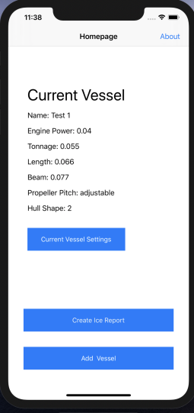
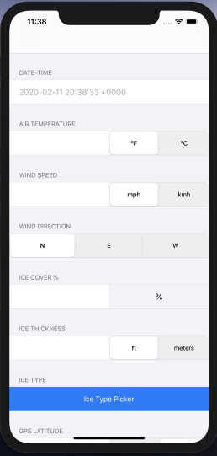
ADAC Program Year 6 Annual Meeting 14 May 2020
Mobile Data Collection App
Interface of an iOS App for facilitating the collection of additional ship-based ICECON observations

Slide 12
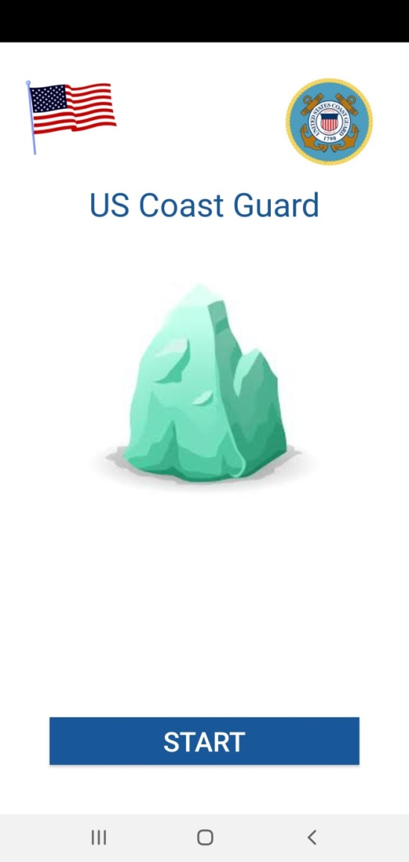
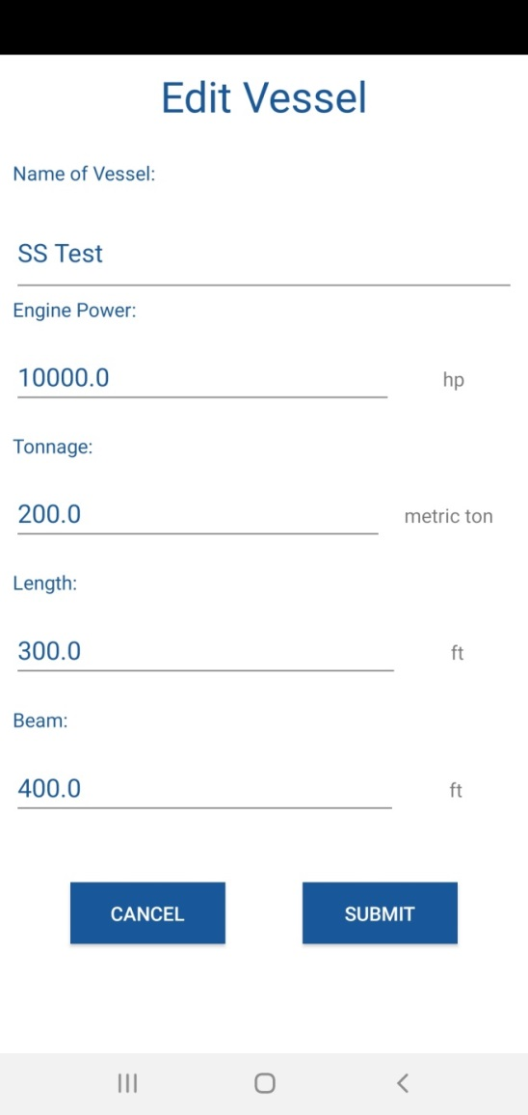
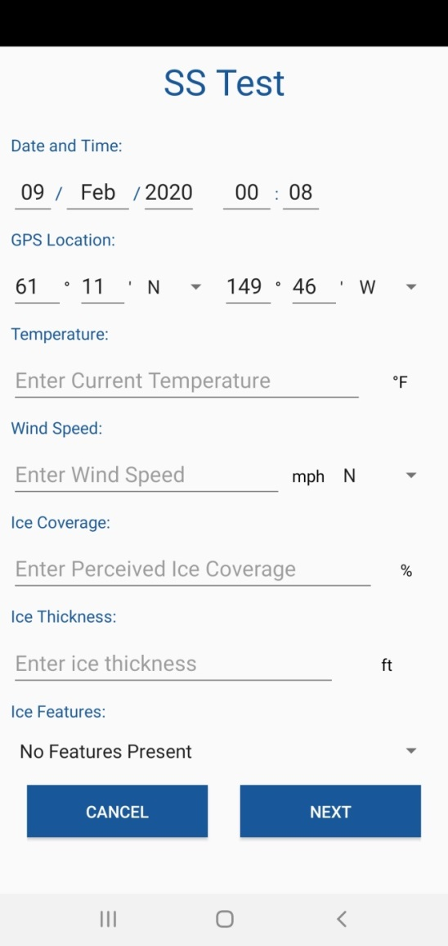
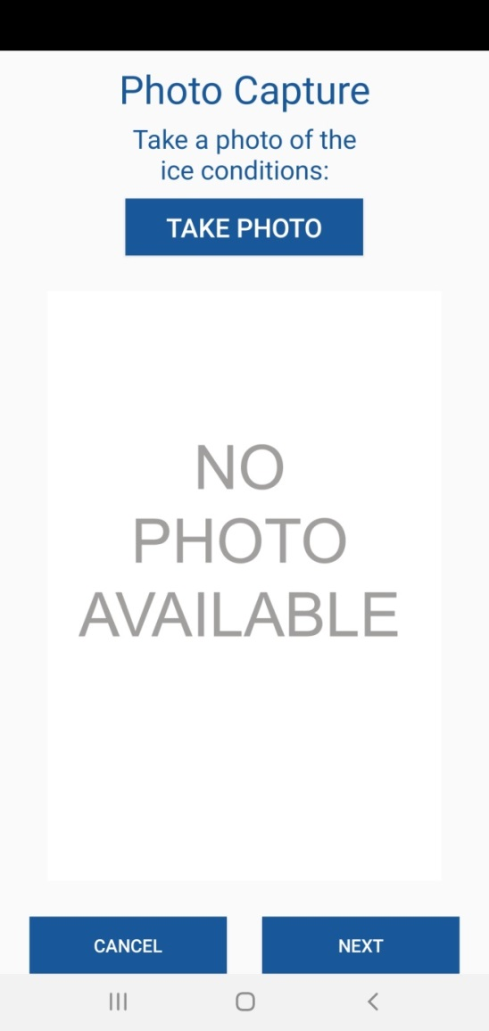
ADAC Program Year 6 Annual Meeting 14 May 2020
Mobile Data Collection App
Interface of an Android App for facilitating the collection of additional ship-based ICECON observations

Slide 13
ADAC Program Year 6 Annual Meeting 14 May 2020
Arctic Ice Conditions Index (ARCTICE)
Description and Baseline
Leveraging team and research skills which developed Great Lakes ICECON, project ARCTICE will develop a high-resolution ice condition index for U.S. Arctic Maritime Exclusive Economic Zone (EEZ), including Bering, Chukchi and Beaufort Sea regions
ARCTICE produces an easy-to-understand numeral to communicate ice conditions that are relevant to the capabilities of an individual vessel. This index will be available for current and future ice conditions, providing forecasts up to 1 month in advance
ARCTICE supports vessel captains and officers in route planning and determining associated risk for traveling through a region of Arctic water

Slide 14
Arctic Ice Conditions Index (ARCTICE)
Description and Baseline
ADAC Program Year 6 Annual Meeting 14 May 2020
Historically many Arctic nations use their own methods for communicating ice conditions. Following the addition of the “POLARIS amendment” to the International Maritime Organization (IMO) Polar Code, communication tools on ice conditions started to migrate to a uniform methodology.
The POLARIS amendment to the IMO Polar Code is based on vetted ice condition processes from the Canadian AIRSS system, the Russian Ice Certificate concept, and additional inputs from other coastal administrators.
While the IMO has no existing or planned international enforcement privileges, the IMO Polar Code is seen as a “best practices” guide, many nations require that vessels comply with the Polar Code.

Slide 15
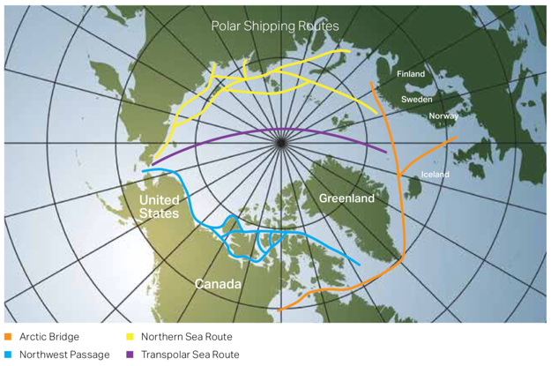
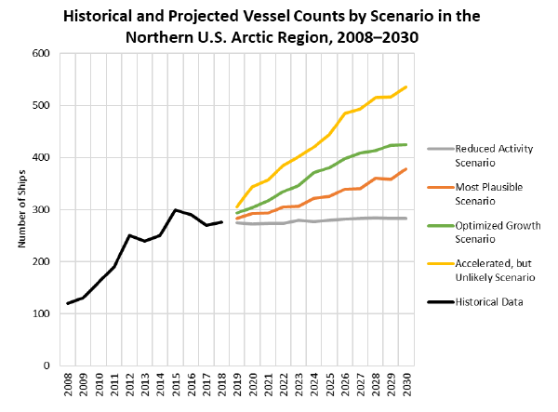
ADAC Program Year 6 Annual Meeting 14 May 2020
Arctic Ice Conditions Index (ARCTICE):
Relevance to DHS and USCG
Retreating sea ice has increased Arctic shipping and transportation viability
Polar shipping routes
From U.S. Committee on the Marine Transportation System

Slide 16
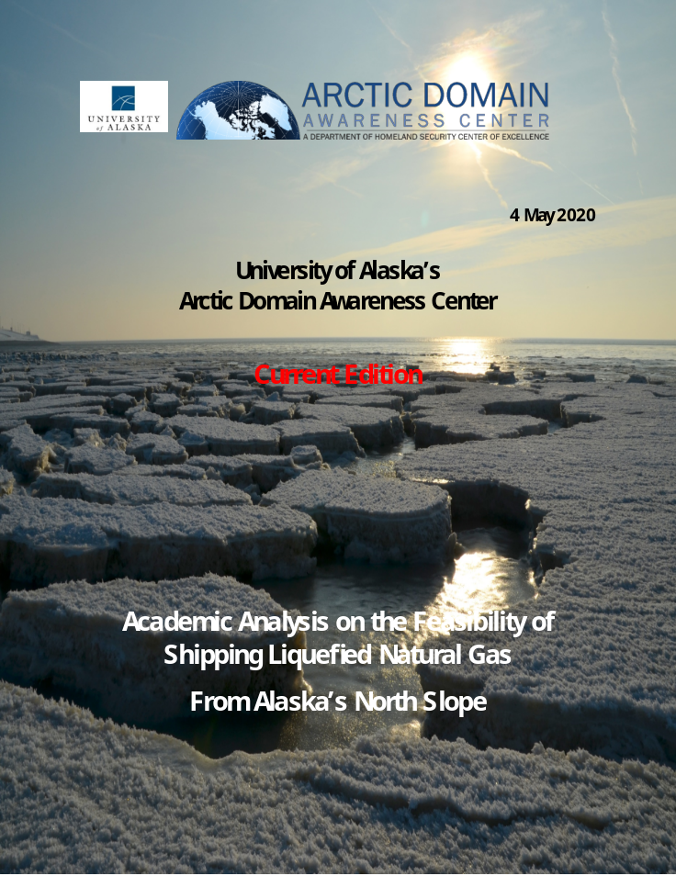
ADAC Program Year 6 Annual Meeting 14 May 2020
Arctic Ice Conditions Index (ARCTICE):
Relevance to DHS and USCG
Vessel traffic in the Arctic regions of Bering, Chukchi and Beaufort Seas is increasing due to:
    Transportation
    Tourism
    Resource development

Slide 17
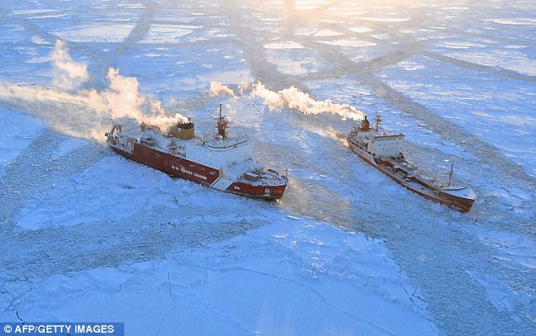
ADAC Program Year 6 Annual Meeting 14 May 2020
Arctic Ice Conditions Index (ARCTICE):
Relevance to DHS and USCG
There is no current publication of the severity of ice conditions and associated risk related to specific vessel classes
In order to ensure the safety and security of the vessels, personnel, and the environment, it is important to develop a high resolution ARCTICE to support Arctic mariner decision making
A small tanker Renda stuck in sea ice near Nome Alaska in 2014

Slide 18
ADAC Program Year 6 Annual Meeting 14 May 2020
Arctic Ice Conditions Index (ARCTICE)
Research Tasks for Year 6
ARCTICE vessel classification system for U.S. Arctic waters
Selection of the ice forecast models and environmental factors to use for ice conditions index for Arctic regions
Develop a forecasted, numeric Arctic ice condition index for Arctic waters
Visualization tool as an aid to vessel mariner planning and underway activities
Investigate suitable access for users

Slide 19
ADAC Program Year 6 Annual Meeting 14 May 2020
Arctic Ice Conditions Index (ARCTICE)
Task 1: vessel classification for U.S. Arctic waters
Polar Code
  Uses International Association of Classification Societies (IACS) vessel classification
  Polar Class: PC 1 to PC 7
  Baltic Class: 1A, 1B, 1C.
American Bureau of Shipping (ABS)
  Arctic class: A5 to A1
  Baltic ice class: A0 to E0
Polar class and Baltic class considerations
  Engine output
  Hull structure design
  Rudder and steering
  Propeller, shafts and gears
  Watertight and weathertight integrity
  Safety
  Communication

Slide 20
ADAC Program Year 6 Annual Meeting 14 May 2020
Arctic Ice Conditions Index (ARCTICE)
Task 1: vessel classification for U.S. Arctic waters
Polar Class | Baltic Class | ABS | Ice description
PC1 |  | A5 | Year-round operation in all Polar waters
PC2 |  | A4 | Year-round operation in moderate multi-year ice conditions
PC3 |  | A3 | Year-round operation in second-year ice with multi-year ice inclusions
PC4 |  | A2 | Year-round operation in thick first-year ice with old ice inclusions
PC5 |  | A1 | Year-round operation in medium first-year ice with old ice inclusions
PC6 |  | A0 | capable of navigating in difficult ice conditions without the assistance of icebreakers
PC7 |  | B0 | capable of navigating in difficult ice conditions, with the assistance of icebreakers when necessary
 | 1A | C0 | capable of navigating in moderate ice conditions, with the assistance of icebreakers when necessary
 | IB | D0 | capable of navigating in light ice conditions, with the assistance of icebreakers when necessary
 | IC | E0 | steel-hulled ships with no ice strengthening that are capable of operating independently in very light ice conditions

Slide 21
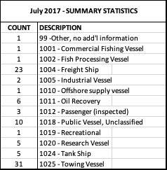
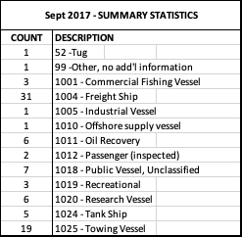
ADAC Program Year 6 Annual Meeting 14 May 2020
Arctic Ice Conditions Index (ARCTICE)
Task 1: vessel classification for U.S. Arctic waters
Surveyed historical AIS data in the US Arctic region;
Pulled unique MMSI (Maritime Mobile Service Identity) IDs for vessel information;
Will use a sampling of the vessels observed in Chukchi and Beaufort to understand vessels transiting in US Arctic.
Notes from the analysis:
Freight and tugs are the most frequent users of these waters
Japanese Research vessels, identified as whalers, were also identified in US EEZ
Russian and Chinese Icebreakers frequent the Chukchi

Slide 22
ADAC Program Year 6 Annual Meeting 14 May 2020
Arctic Ice Conditions Index (ARCTICE)
Task 2: ice forecast model for ARCTICE
Selected High-resolution Ice-Ocean Modeling and Assimilation System (HIOMAS) model among other models:
  ice and ocean current forecast data on high-resolution (1 km) grid for US Arctic EEZ
  forecast of ice condition up to 1 month
  spatial distribution of ice motion and thickness
  the area fraction of thick-ridged or multi-year ice

Slide 23
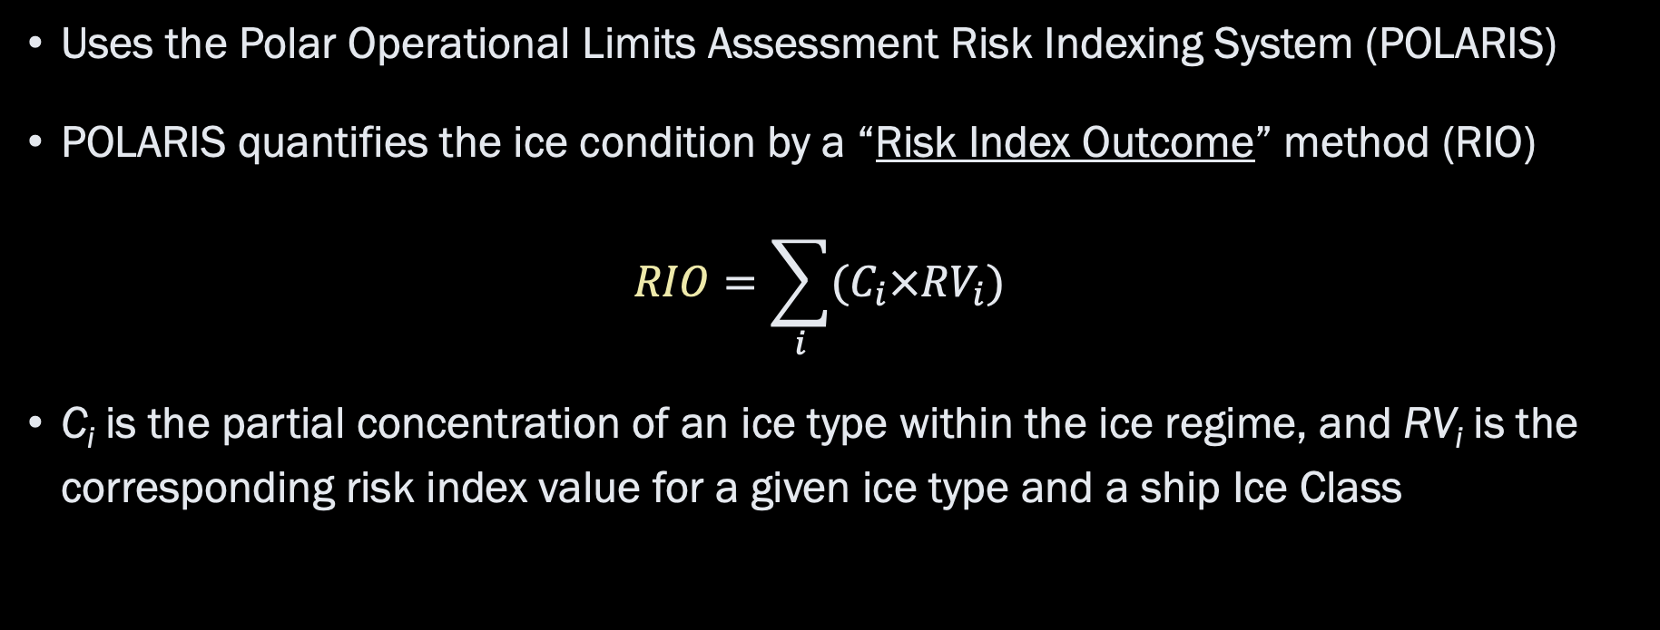
ADAC Program Year 6 Annual Meeting 14 May 2020
Arctic Ice Conditions Index (ARCTICE)
Task 3: a forecasted, numeric Arctic ice condition index
Uses the Polar Operational Limits Assessment Risk Indexing System (POLARIS)
POLARIS quantifies the ice condition by a “Risk Index Outcome” method (RIO)
$$RIO=\sum_{i}{(C_{i}×{RV}_{i})}$$
C_{i} is the partial concentration of an ice type within the ice regime, and RV_{i} is the corresponding risk index value for a given ice type and a ship Ice Class

Slide 24
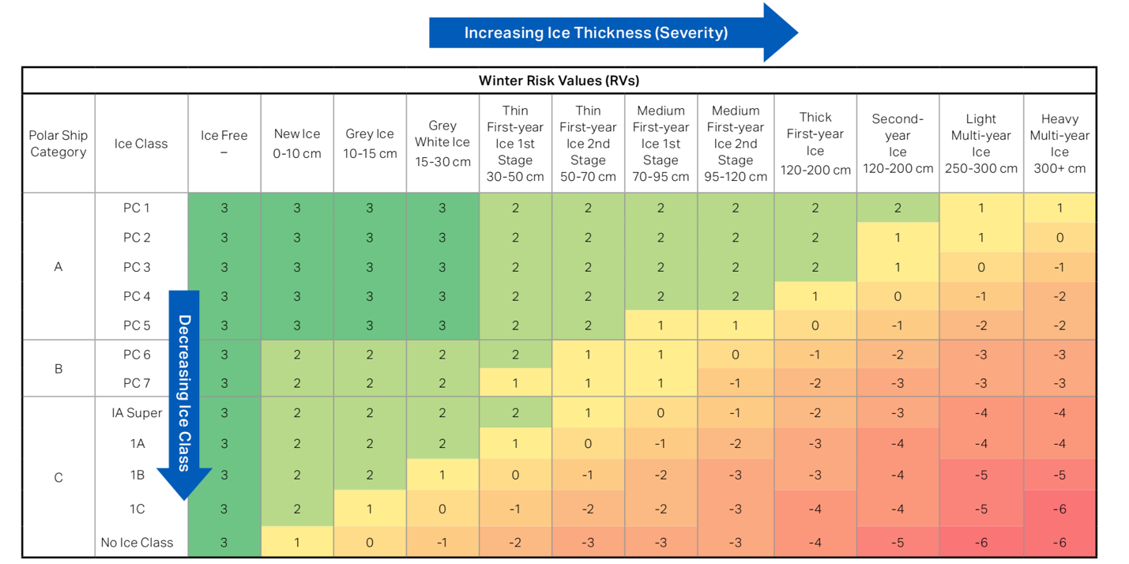
ADAC Program Year 6 Annual Meeting 14 May 2020
Arctic Ice Conditions Index (ARCTICE)
Task 3: a forecasted, numeric Arctic ice condition index
Values of RV_{i} for ice type and Ice Class

Slide 25
ADAC Program Year 6 Annual Meeting 14 May 2020
Arctic Ice Conditions Index (ARCTICE)
Task 3: a forecasted, numeric Arctic ice condition index
Interpolate RIO with ice conditions for a ship
RIO | Ice Classes PC1-PC7 | Ice Class below PC7 or not assigned
RIO ≥ 0 | Normal sailing | Normal sailing
-10 ≤ RIO < 0 | Elevated sailing risk, proceed sailing with caution | Sailing subject to special consideration (i.e., sailing not recommended)
RIO < -10 | Sailing subject to special consideration (i.e., sailing not recommended) | Sailing subject to special consideration (i.e., sailing not recommended)

Slide 26
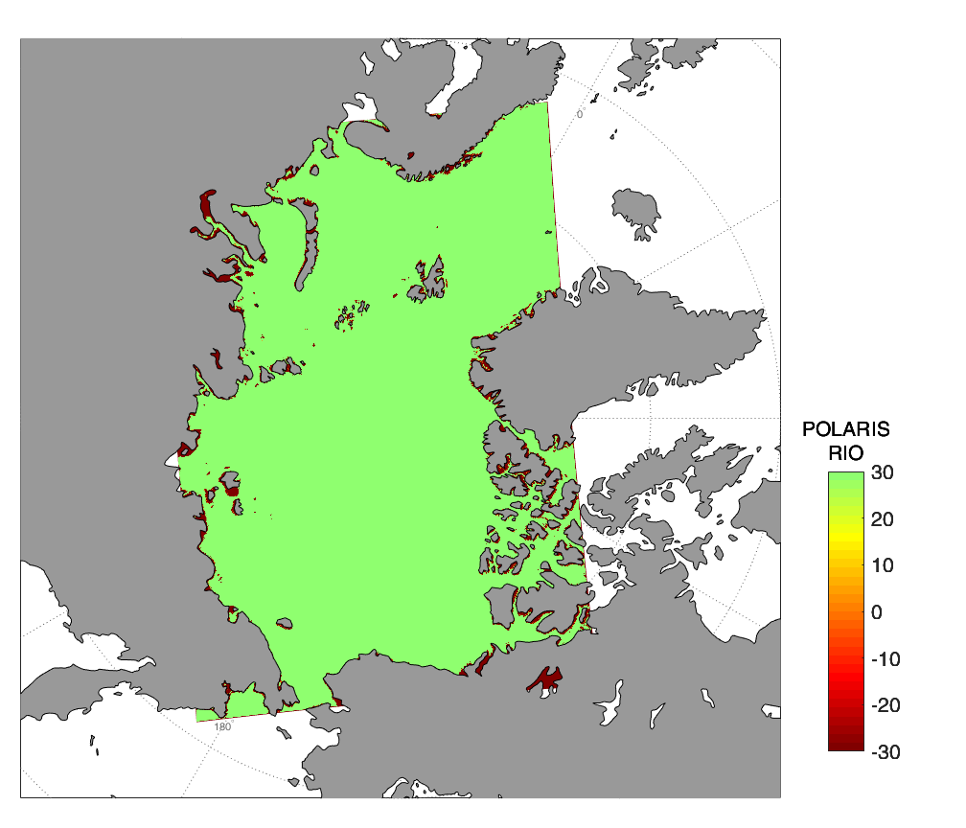
ADAC Program Year 6 Annual Meeting 14 May 2020
Arctic Ice Conditions Index (ARCTICE)
Task 4: a visualization tool as an aid to vessel mariner
RIO | Ice Classes PC1-PC7 | Ice Class below PC7 or not assigned
RIO ≥ 0 | Normal sailing | Normal sailing
-10 ≤ RIO < 0 | Elevated sailing risk, proceed sailing with caution | Sailing subject to special consideration (i.e., sailing not recommended)
RIO < -10 | Sailing subject to special consideration (i.e., sailing not recommended) | Sailing subject to special consideration (i.e., sailing not recommended)
RIO for PC 1

Slide 27
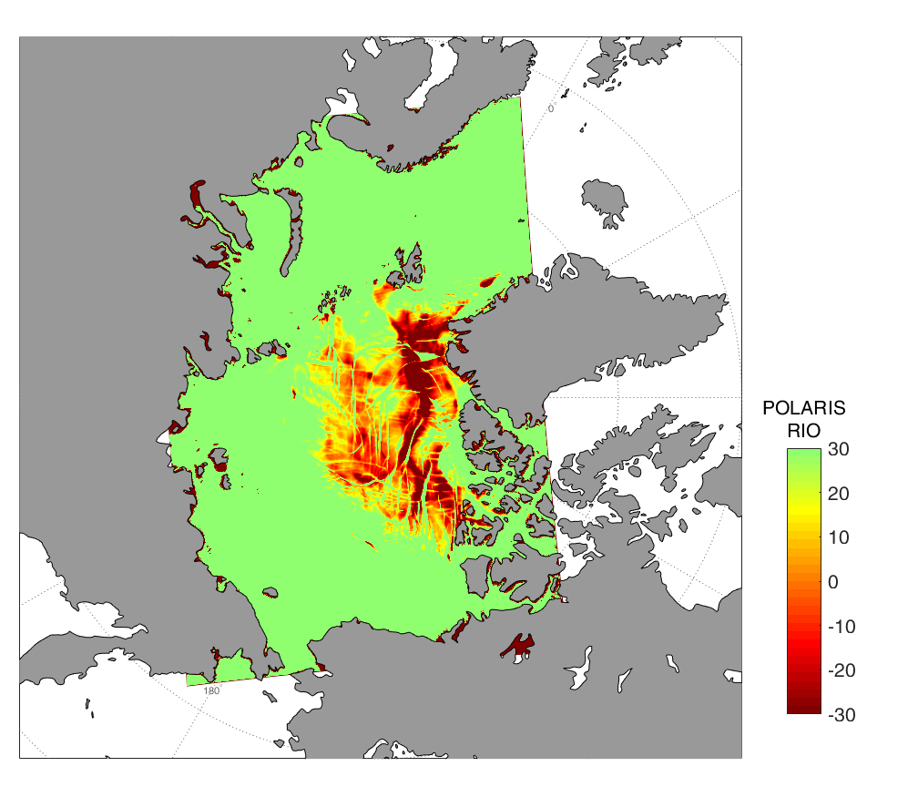
ADAC Program Year 6 Annual Meeting 14 May 2020
Arctic Ice Conditions Index (ARCTICE)
Task 4: a visualization tool as an aid to vessel mariner
RIO | Ice Classes PC1-PC7 | Ice Class below PC7 or not assigned
RIO ≥ 0 | Normal sailing | Normal sailing
-10 ≤ RIO < 0 | Elevated sailing risk, proceed sailing with caution | Sailing subject to special consideration (i.e., sailing not recommended)
RIO < -10 | Sailing subject to special consideration (i.e., sailing not recommended) | Sailing subject to special consideration (i.e., sailing not recommended)
RIO for PC 5

Slide 28
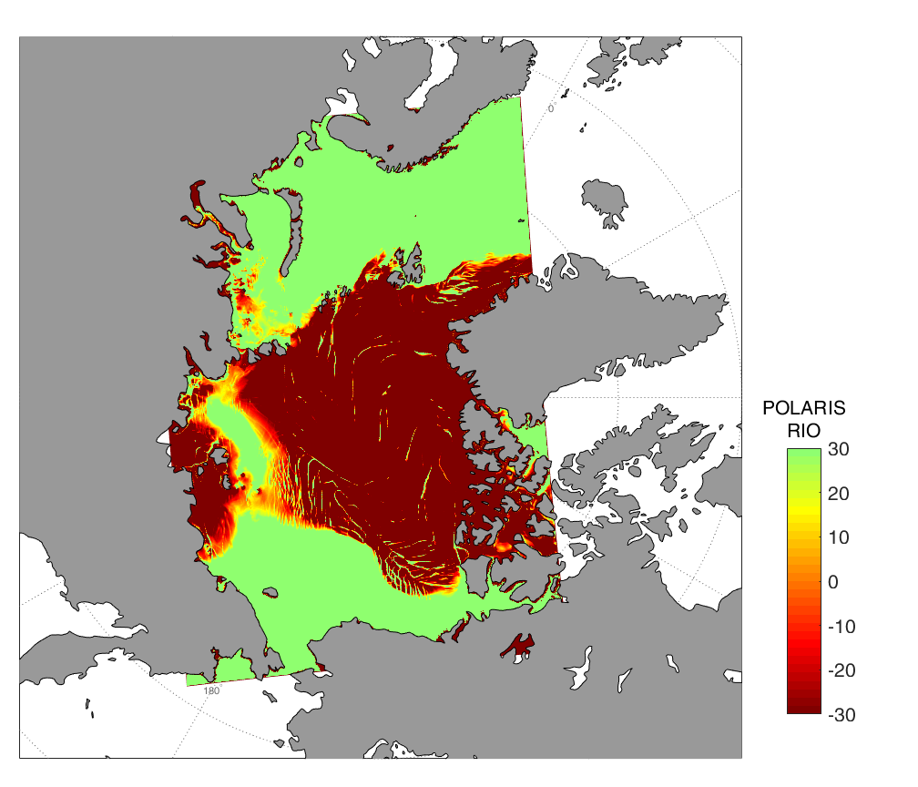
ADAC Program Year 6 Annual Meeting 14 May 2020
Arctic Ice Conditions Index (ARCTICE)
Task 4: a visualization tool as an aid to vessel mariner
RIO | Ice Classes PC1-PC7 | Ice Class below PC7 or not assigned
RIO ≥ 0 | Normal sailing | Normal sailing
-10 ≤ RIO < 0 | Elevated sailing risk, proceed sailing with caution | Sailing subject to special consideration (i.e., sailing not recommended)
RIO < -10 | Sailing subject to special consideration (i.e., sailing not recommended) | Sailing subject to special consideration (i.e., sailing not recommended)
RIO for PC 7

Slide 29
ADAC Program Year 6 Annual Meeting 14 May 2020
Arctic Ice Conditions Index (ARCTICE)
Task 4: a visualization tool as an aid to vessel mariner
Final products in .png formats of POLARIS index map
POLARIS also in geotiff format for USNIC
Publication on Axiom Data Science server and distributed through email subscription

Slide 30
ADAC Program Year 6 Annual Meeting 14 May 2020
Arctic Ice Conditions Index (ARCTICE)
Task 5: Investigate suitable access
Discuss with D17 on the most suitable approach to publish the Ice Condition Index for easy access for mariners
Challenges such as long distances between ports of call, communication shortfalls, etc.
Ensuring ease of access to ARCTICE for Arctic mariners
Understand the vessels in the Arctic and their communication capabilities

Slide 31
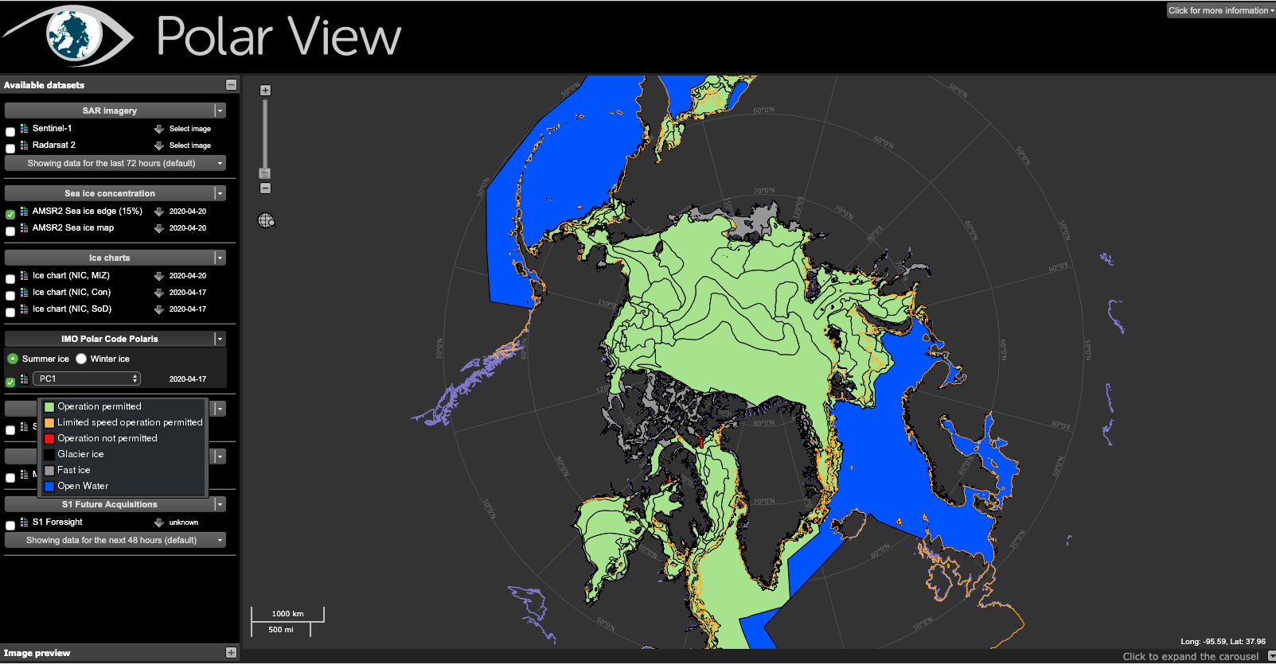
ADAC Program Year 6 Annual Meeting 14 May 2020
Arctic Ice Conditions Index (ARCTICE)
Task 6: Compare ARCTICE index with field data
Though focusing on US Arctic, ARCTICE can provide ice condition index for the pan-Arctic, allowing the use of incident reports from all Arctic waters
Collected data on a few vessel/ice accident reports from Canada and we are in process of analysis and
comparison with ARCTIC
index
Comparison with Polar View,
from the European Space
Agency

Slide 32
ADAC Program Year 6 Annual Meeting 14 May 2020
Arctic Ice Conditions Index (ARCTICE)
Future Work
Discussion with Alaska coastal communities to explore potential collaborations
Automate the forecast numeric Arctic ice condition index for Arctic waters
Transition the ARCTICE to an operational destination
  SOW established with project partner Axiom Data Science
  Infrastructure similar to GL ICECON operation
Explore an east-coast version of ARCTICE for USCG D1

Slide 33
ADAC Program Year 6 Annual Meeting 14 May 2020
Ready for Questions
Feedback…
What are we missing?
What can we improve?
Who should we connect with to improve odds of research success?
Notes:
Thank you for the gift of your time and attention.

